Slide 1
GAS DETECTOR VEHICLE
Made By Team SINGLES
Members:
Priya srivastav
Neehit goyal
Narayan kaushik

Slide 2
AIM
To detect major harmful gases ppm values.
To make an autonomus as well as manual bot which could move to places where humans cannot reach(hazardous gas places)
To get the data of gases and use this data in air quality monitoring

Slide 3
PRINCIPLES
MQ Series Gas Sensors collect data about various gases present in the atmosphere.
IR sensors detects the path to be followed.
DHT sensor collect the data about temperature and humidity.

Slide 4
COMPONENTS
Arduino UNO
Mq series
ESP8266 module
Bluetooth hc05
DHT
IR sensors
L298N motor driver
dc motors
battery 12v
wheels

Slide 5
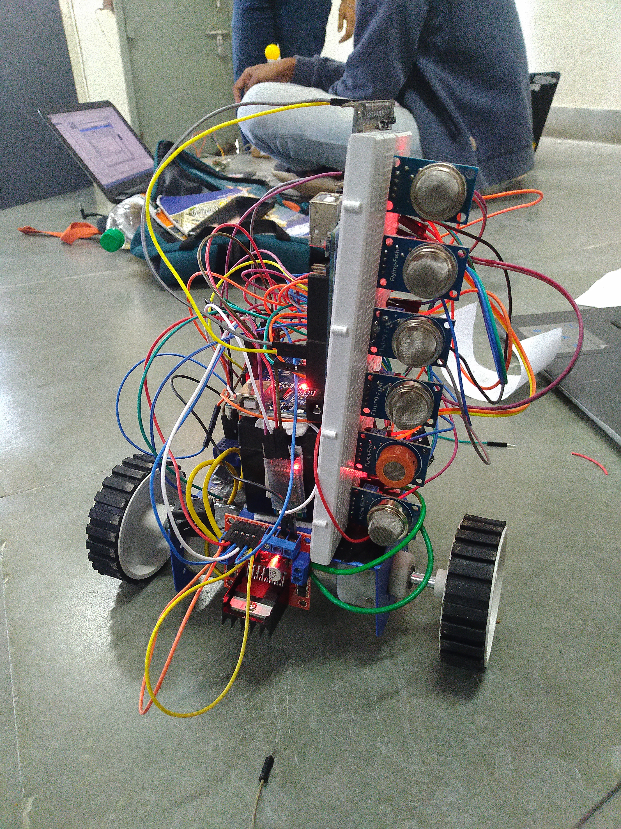
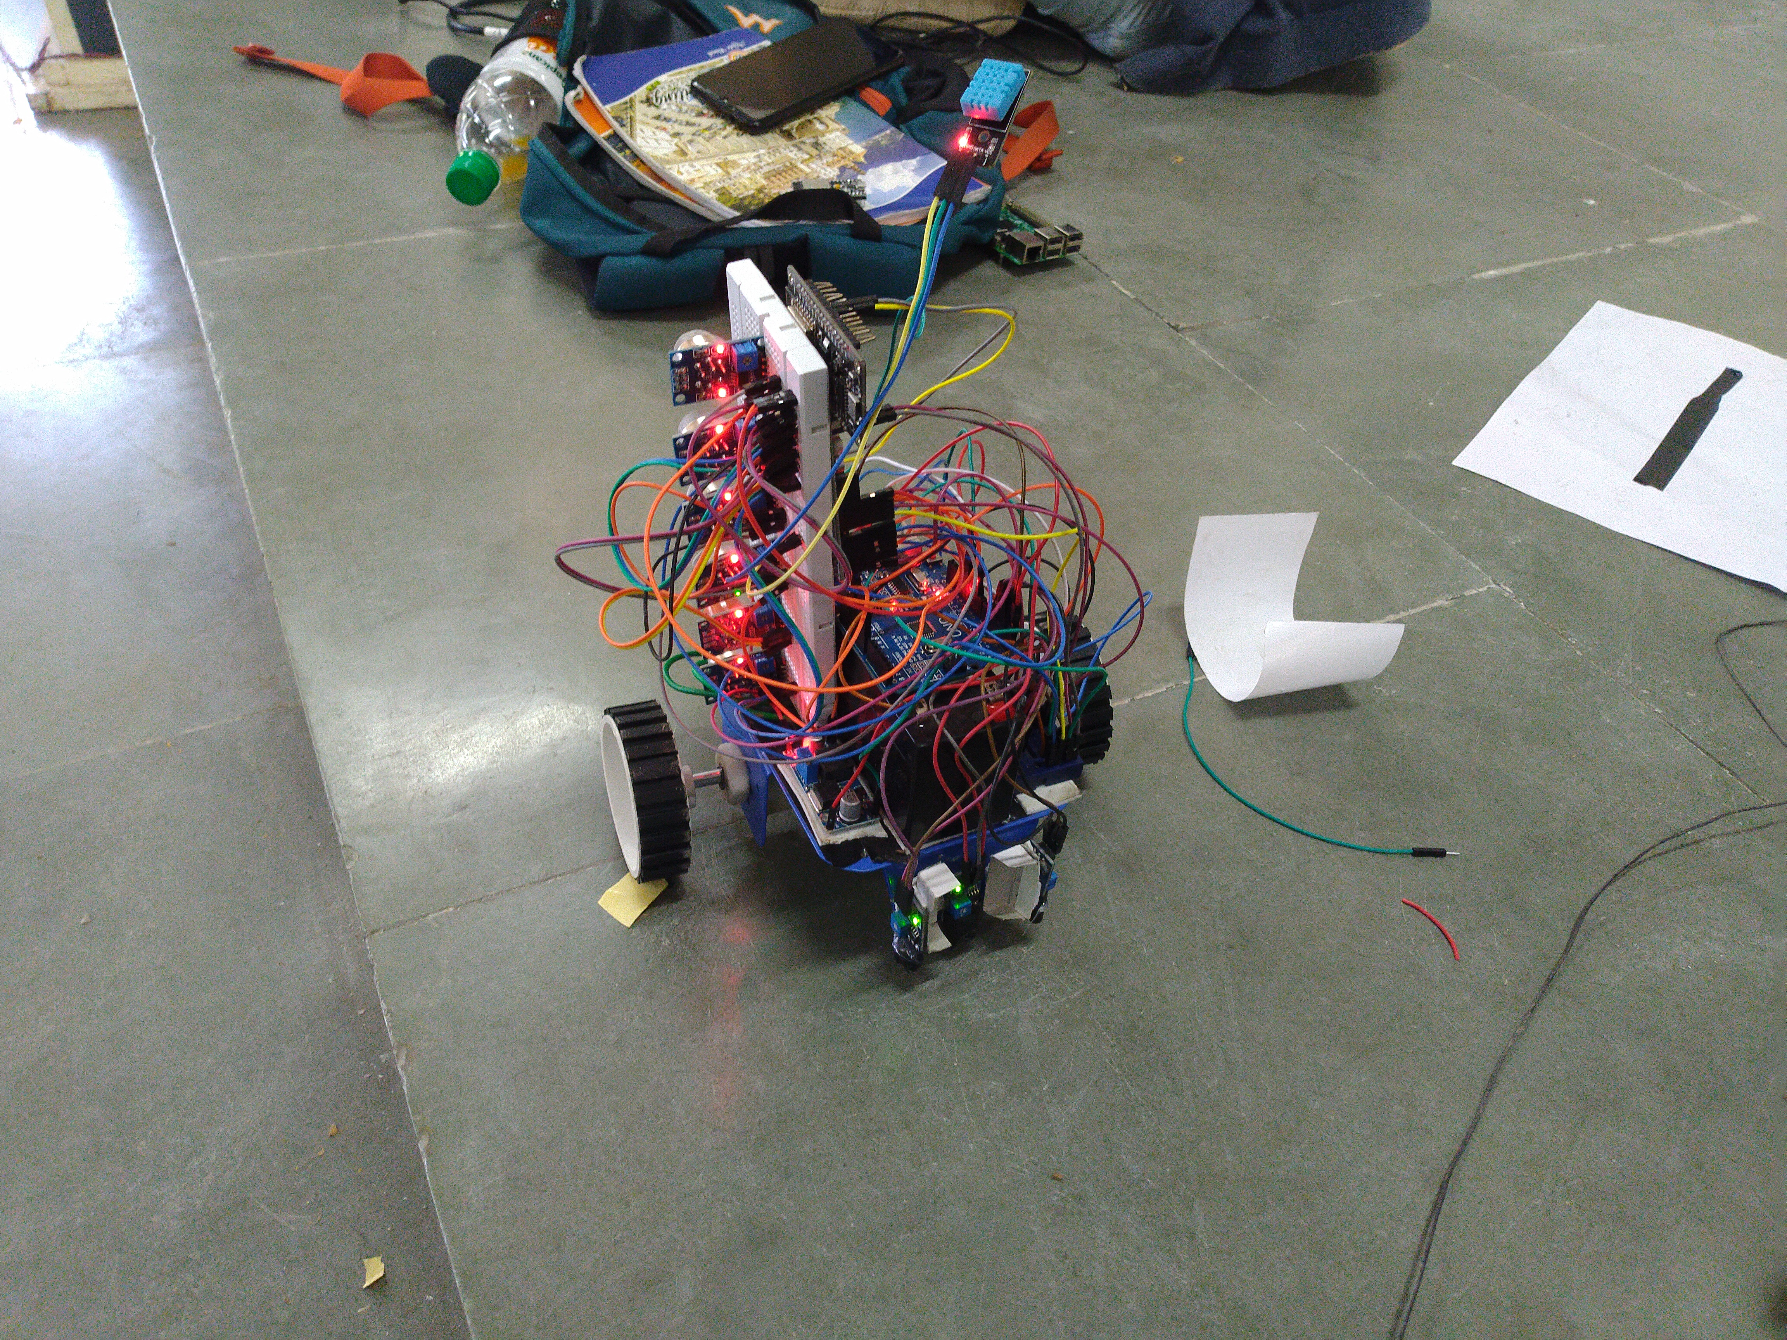
FINAL OUTPUTS:

Slide 6
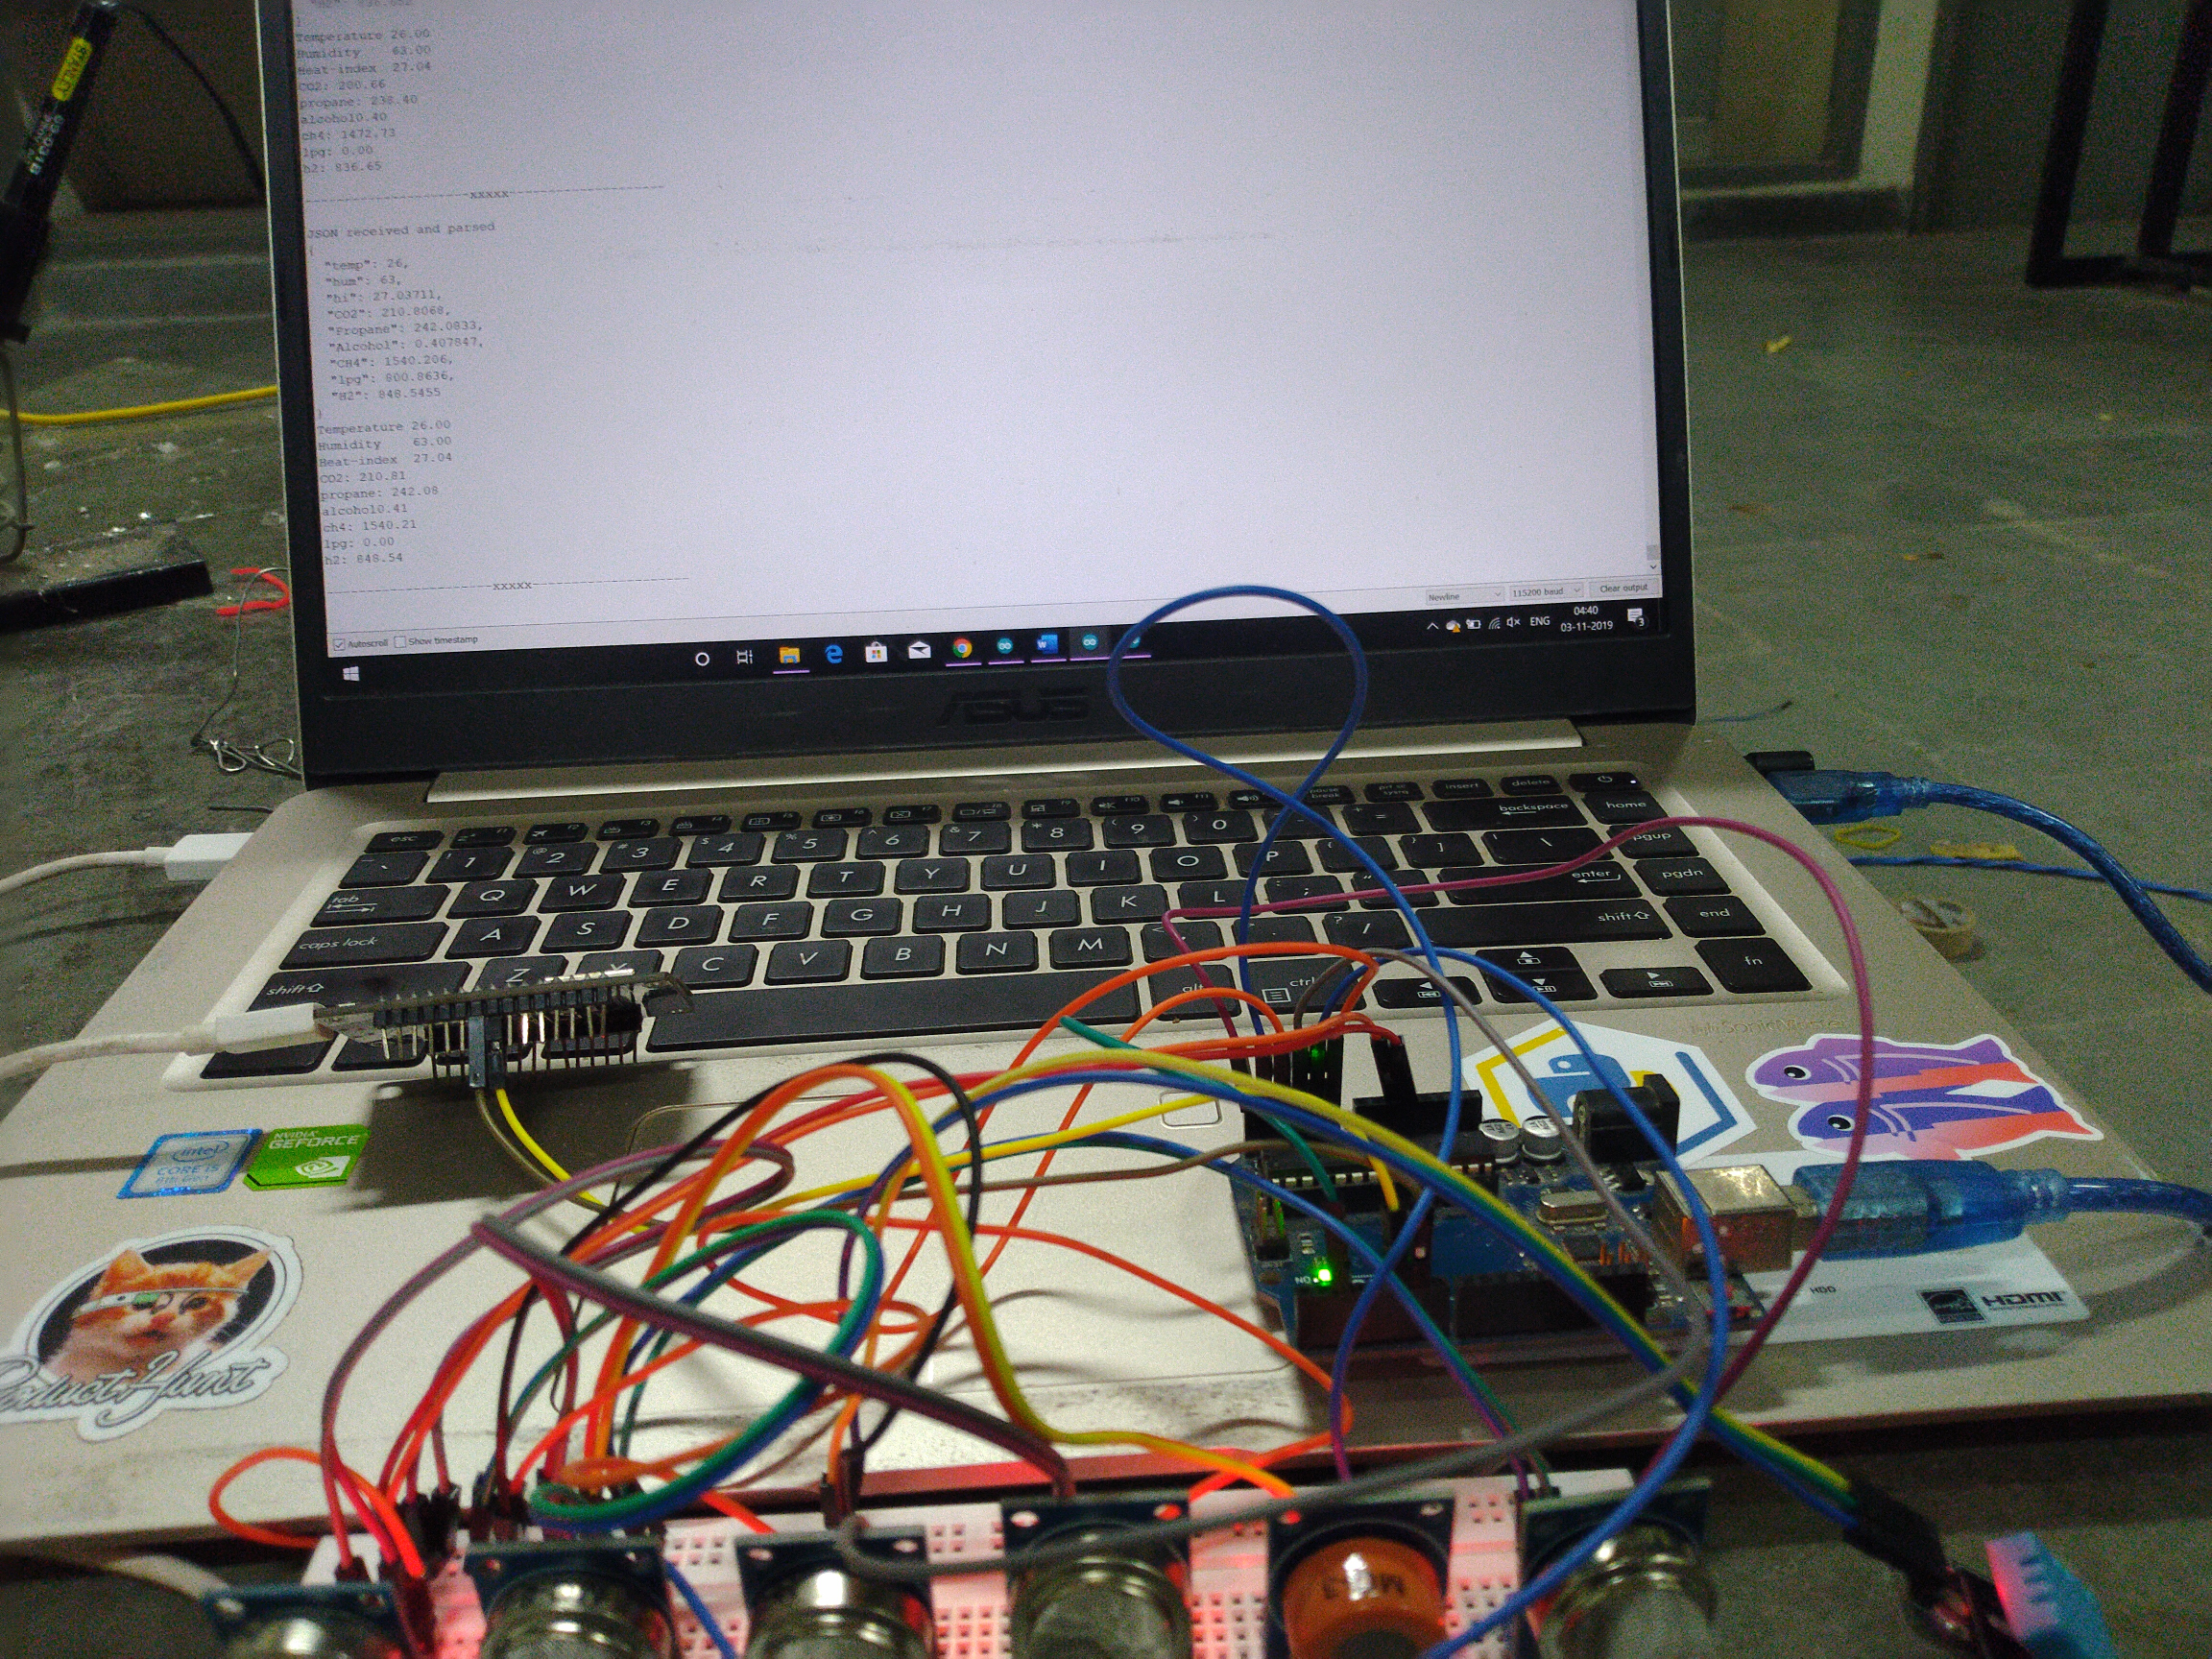
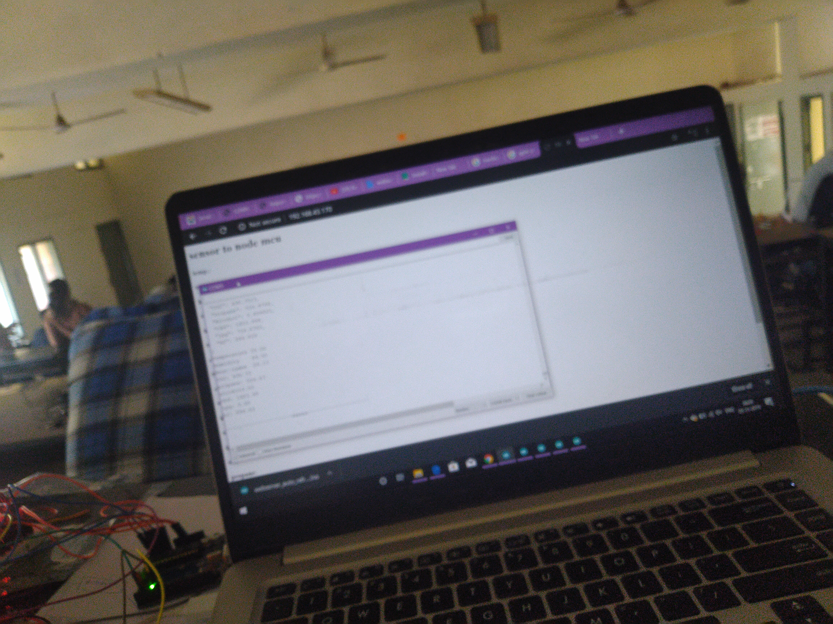

Slide 7
APPLICATIONS
Underground parkings
Laboratories
Near volcanoes etc.
Around Chemical factories.

Slide 8
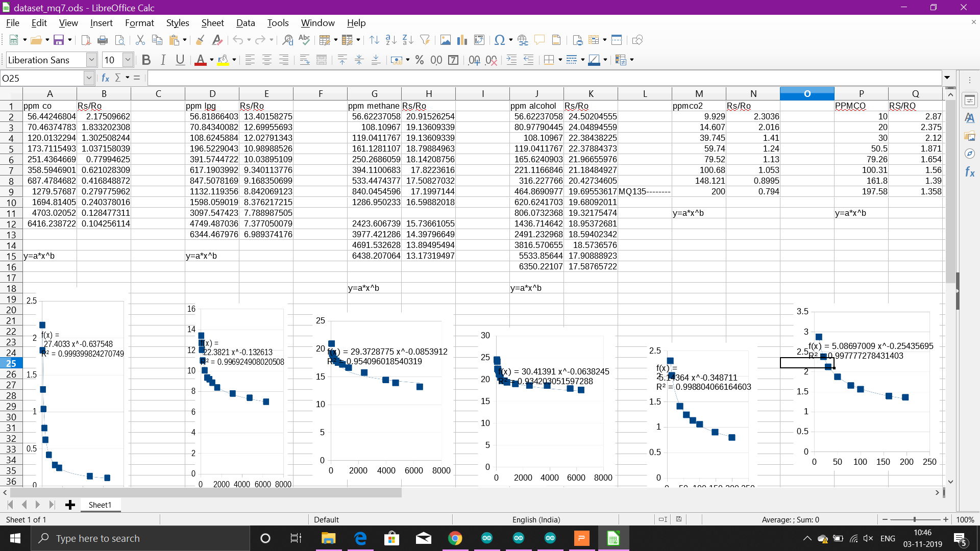
Mq sensor equation calculated for accurate ppm values

Slide 9
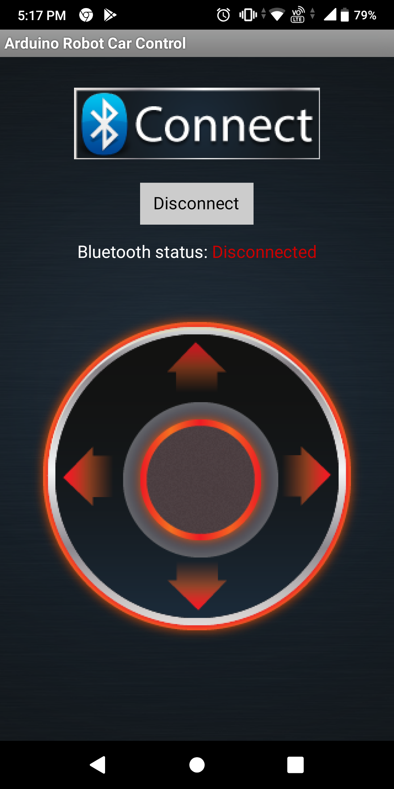
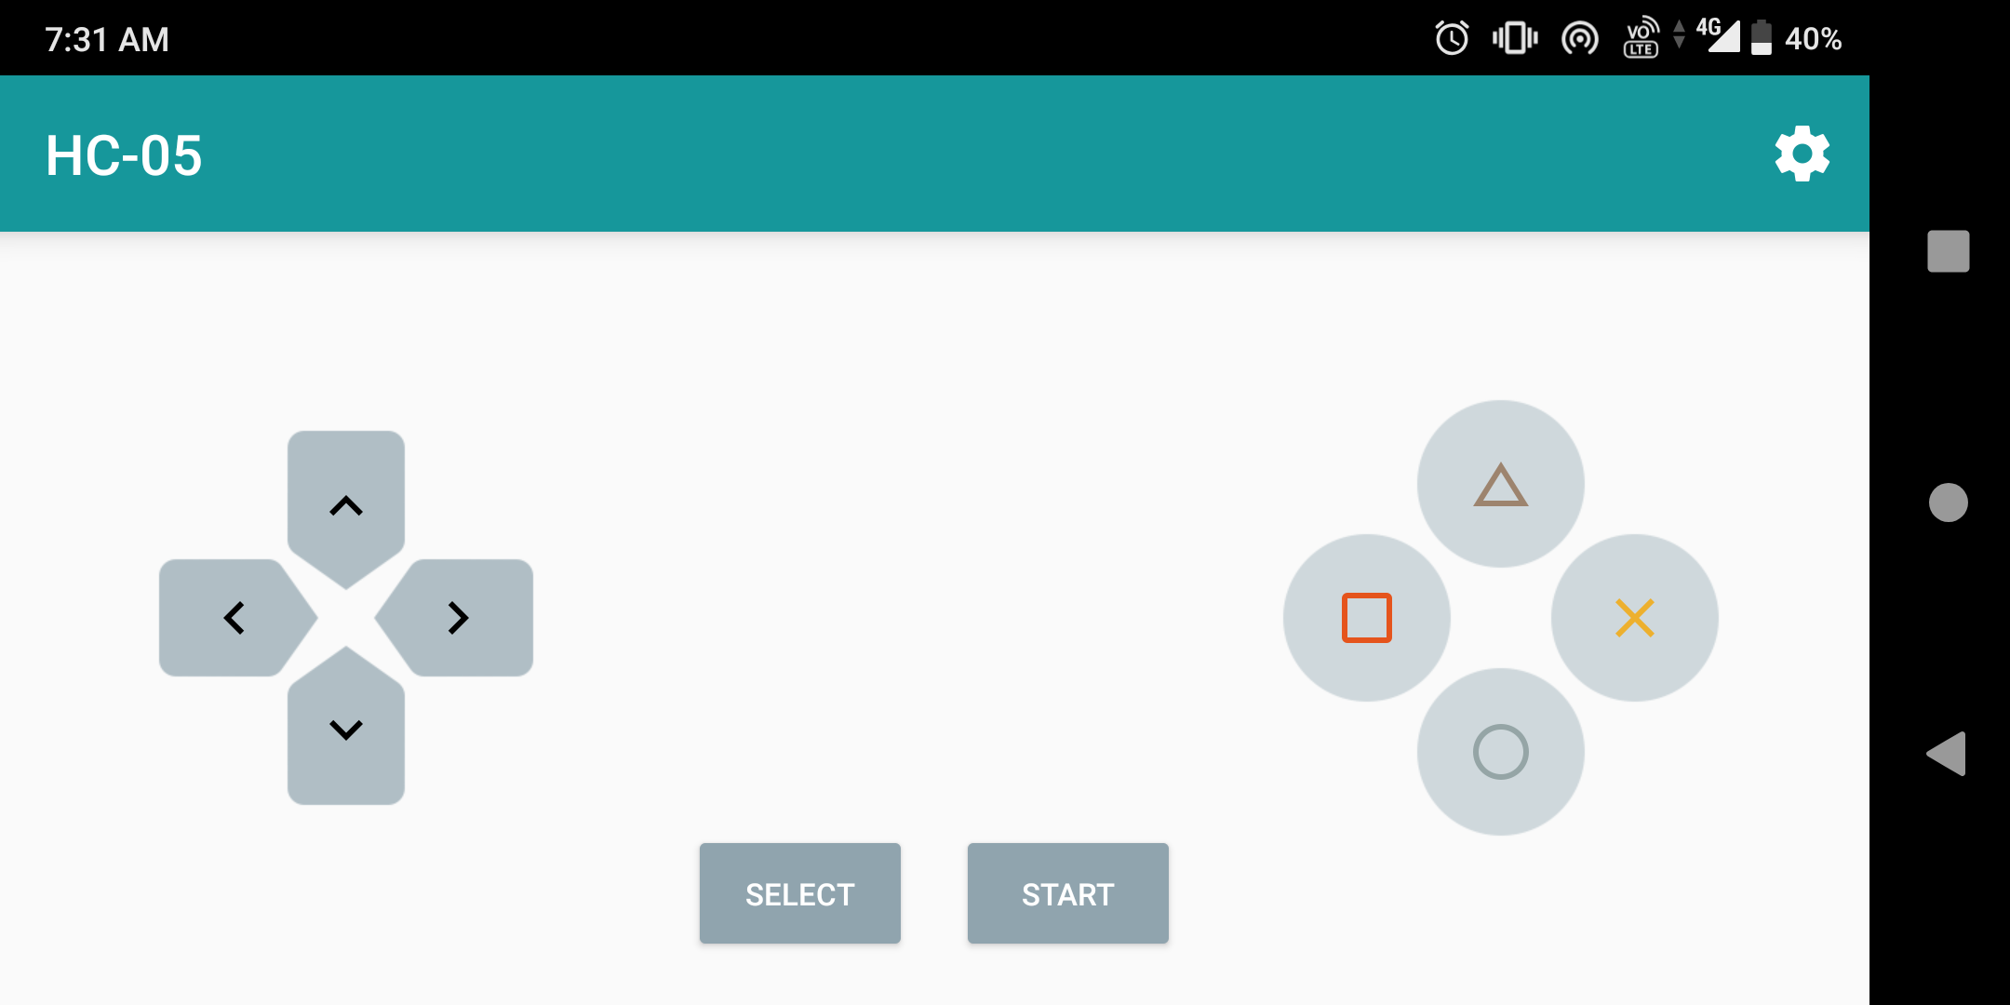
Apps we built using mit app inventer

